Slide 1

Choosing and adjusting a method
TUHE 2017

Slide 2
Agenda
RUP – made agile
Parameters for choosing methods (Boehm)
Time to:
Study point assignment
Report

Slide 3
RUP - Rational Unified Process
Notes:
http://www.drdobbs.com/skinnier-rup/184415143?cid=Ambysoft

Slide 4
Four management phases
The Rational Unified Process (RUP) is a software development process from Rational, a division of IBM.
It divides the development process into four distinct phases that each involve business modeling, analysis and design, implementation, testing, and deployment.
The four phases are:
Inception
Elaboration
Construction
Transition
RUP is a specific implementation of the Unified Process.

Slide 5
Organization along time
Major Milestones
Organization along content

Slide 7
Inception
Construction
Transition
Elaboration
During the inception phase, you establish the business case for the system and delimit the project scope.
The outcome of the inception phase is:
A vision document: a general vision of the core project's requirements, key features, and main constraints
A initial use-case model (10% -20%) complete)
An initial project glossary (may optionally be partially expressed as a domain model)
An initial business case, which includes business context, success criteria and financial forecast
An initial risk assessment
A project plan, showing phases and iterations
A business model, if necessary
One or several prototypes

Slide 8
Inception
Construction
Transition
Elaboration
At the end of the inception phase is the first major project milestone
The Lifecycle Objectives Milestone
The evaluation criteria for the inception phase are:
Stakeholder concurrence on scope definition and cost/schedule estimates
Requirements understanding as evidenced by the fidelity of the primary use cases
Credibility of the cost/schedule estimates, priorities, risks, and development process
Depth and breadth of any architectural prototype that was developed
Actual expenditures versus planned expenditures.
The project may be cancelled or considerably re-thought if it fails to pass this milestone.

Slide 9
Inception
Construction
Transition
Elaboration
The purpose of the elaboration phase is to analyze the problem domain, establish a sound architectural foundation, develop the project plan, and eliminate the highest risk elements of the project.
The outcome of the elaboration phase is:
A use-case model (at least 80% complete) — all use cases and actors have been identified, and most use-case descriptions have been developed
Supplementary requirements capturing the non functional requirements and any requirements that are not associated with a specific use case
A Software Architecture Description
An executable architectural prototype
A revised risk list and a revised business case
A development plan for the overall project, including the coarse-grained project plan, showing iterations” and evaluation criteria for each iteration
An updated development case specifying the process to be used
A preliminary user manual (optional)

Slide 10
Inception
Construction
Transition
Elaboration
At the end of the elaboration phase is the second important project milestone, the Lifecycle Architecture Milestone. You examine the detailed system objectives and scope, the choice of architecture, and the resolution of the major risks.
The main evaluation criteria for the elaboration phase :
Is the vision of the product stable?
Is the architecture stable?
Does the executable demonstration show that the major risk elements have been addressed and credibly resolved?
Is the plan for the construction phase sufficiently detailed and accurate? Is it backed up with a credible basis of estimates?
Do all stakeholders agree that the current vision can be achieved if the current plan is executed to develop the complete system, in the context of the current architecture?
Is the actual resource expenditure versus planned expenditure acceptable?
The project may be aborted or considerably re-thought if it fails to pass this milestone.

Slide 11
Inception
Construction
Transition
Elaboration
During the construction phase, all remaining components and application features are developed and integrated into the product, and all features are thoroughly tested.
The outcome of the construction phase is a product ready to put in hands of its end-users. At minimum, it consists of:
The software product integrated on the adequate platforms
The user manuals
A description of the current release

Slide 12
Inception
Construction
Transition
Elaboration
At this point, you decide if the software, the sites, and the users are ready to go operational, without exposing the project to high risks. This release is often called a “beta” release.
The evaluation criteria for the construction phase involve answering these questions:
Is this product release stable and mature enough to be deployed in the user community?
Are all stakeholders ready for the transition into the user community?
Are the actual resource expenditures versus planned expenditures still acceptable?

Slide 13
Inception
Construction
Transition
Elaboration
The purpose of the transition phase is to transition the software product to the user community.
This typically requires that some usable subset of the system has been completed to an acceptable level of quality and that user documentation is available so that the transition to the user will provide positive results for all parties.
This includes:
“Beta testing” to validate the new system against user expectations
Parallel operation with a legacy system that it is replacing
Conversion of operational databases
Training of users and maintainers
Roll-out the product to the marketing, distribution, and sales teams

Slide 14
Inception
Construction
Transition
Elaboration
The transition phase focuses on the activities required to place the software into the hands of the users.
Typically, this phase includes several iterations, including beta releases, general availability releases, as well as bug-fix and enhancement releases.
The primary objectives of the transition phase include:
Achieving user self-supportability
Achieving stakeholder concurrence that deployment baselines are complete and consistent with the evaluation criteria of the vision
Achieving final product baseline as rapidly and cost effectively as practical

Slide 15
Inception
Construction
Transition
Elaboration
At the end of the transition phase is the fourth important project milestone, the Product Release Milestone.
At this point, you decide if the objectives were met, and if you should start another development cycle. In some cases, this milestone may coincide with the end of the inception phase for the next cycle.
The primary evaluation criteria for the transition phase involve the answers to these questions:
Is the user satisfied?
Are the actual resources expenditures versus planned expenditures still acceptable?

Slide 16
Is RUP – Agile?
When it comes to making RUP agile, the critical issues are philosophical:
Encompassing agility isn’t about adopting the right tool or technique, it’s about the mindset.
The essence of agility isn’t a technique—it’s a willingness to focus on people, the development of working software, the pursuit of active stakeholder participation and the embrace of change.

Slide 17
Collaboration is the foremost hallmark of agility. How do you achieve this within RUP?
Build a team of people who want to work together, learn from each other and succeed together. Seems obvious, but how many projects have you been on that included people simply because they were available?
Support everyone’s learning efforts with training, mentoring and coaching
Break down communication barriers: Colocate the team and get your project stakeholders actively involved in development
Recognize common “process smells” that indicate serious communication problems. For example, the belief that you need detailed documentation is one such smell

Slide 18
Rebalancing Your Organization’s Agility and Discipline
Boehm

Slide 19
Balancing agility and discipline (Boehm)
Criteria's for choosing the right method
Size
Number of participant
Mission’s criticality
Consequences/loss due to impact of errors
Skills
Level of experience
Dynamic
Number of changes pr. month in %
Culture
Number that thrives on chaos – numbers that thrives on order

Slide 20
Skill levels
Level -1: They should be rapidly identified and found other work to do!!
Level 1B: Less experienced developers
They can function well in performing straightforward software development in a stable situation
They will slow down an agile team trying to cope with rapid change
Level 1A:
They can function well on agile or disciplined teams if there are enough Level 2 developers to guide them
Level 2:
They can function well in managing a small, known agile or
disciplined project
But need the guidance of Level 3 people on a large or unknown projects
Level 3:
Very experienced
Can manage both agile and disciplined projects

Slide 21
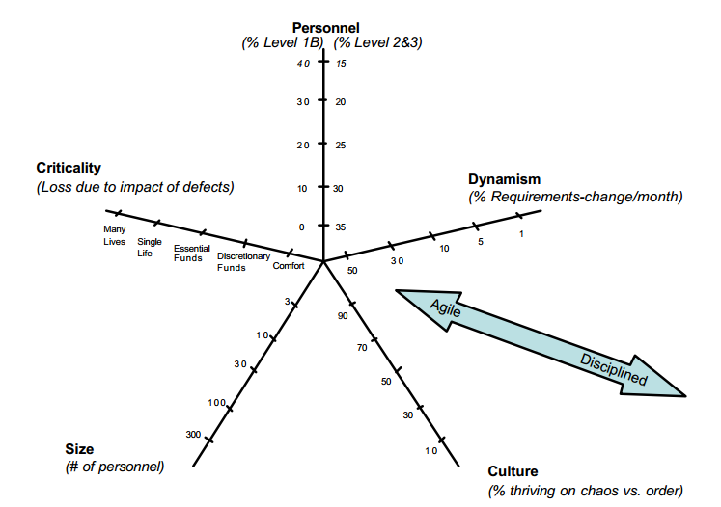
Boehm’s model

Slide 22
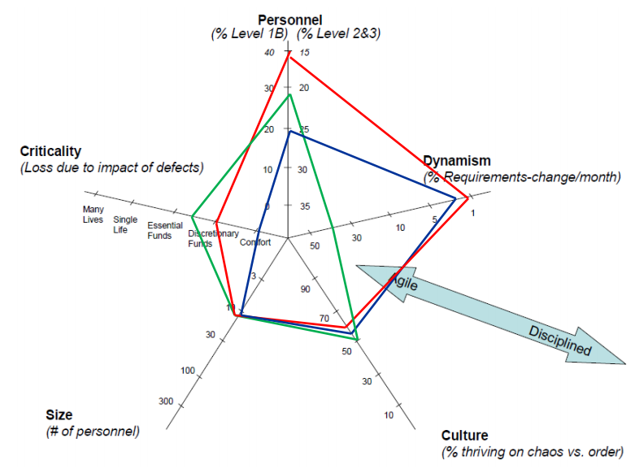
Example

Slide 23
Exercise
Argue for why being in the periphery favours a disciplined approach
Argue for why being near the centre favours an agile approach
Wouldn’t a small highly skilled development team always be rather successful?
Characterize your semester project in Boehm’s 5 dimensions
Evaluate based on the characterisation which method that would have been best suited

